Slide 1




Project:
CusX
A new project innovating customer experience.
[A prototype]

Slide 2
Outline
Red Hat products used
Demonstrations
Next Steps
Source codes

Slide 3
Red Hat products used:-
Red Hat studio code
Red Hat Fuse for Integration
Red Hat AMQ for real time messaging
Red Hat DataGrid for security
Openshift

Slide 4
Why we chose this?
In this present era, there are many innovative ideas coming up and they need to be shaped faster else it remains as a dream for many.
Maybe sometimes we get an idea of having a product which can solve our issue.Hence , we have presented our proto to provide tools which can be fruitful in the way.
This prototype resolves many issues which customers face in their day-to-day life.

Slide 5
What customers do today?
Our services received good feedback from it’s users
Some say our products are really fast and easy to scale.
Really useful for some to get with their startups.
Others say a great innovation towards development of applications.

Slide 6
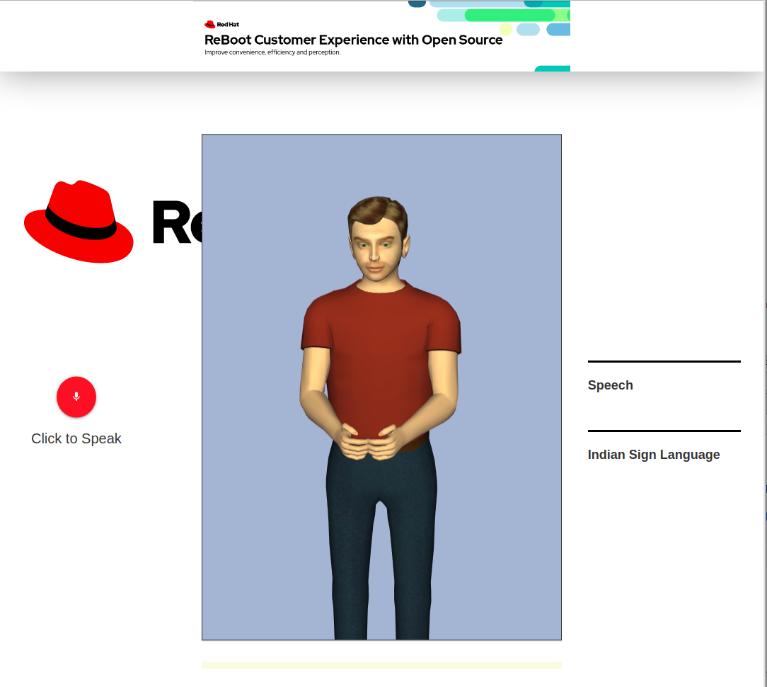
Sharu
01
1
A platform for deaf customers to express their searching demand.
Their voice is analysed and demonstrated as visual 3D gestures.
Uses:- Deaf coaching centres, applications with voice output like Google echo, Alexa or Pdf readers can use this.

Slide 7
Jyoti
02
82%
A project that aims to help the blind see how much we care for them.
It implements mapping and voice to text and back to voice feature for those who are handicapped or blind.
Customers satisfied using this.
As rated by 10 customers who have used this

Slide 8
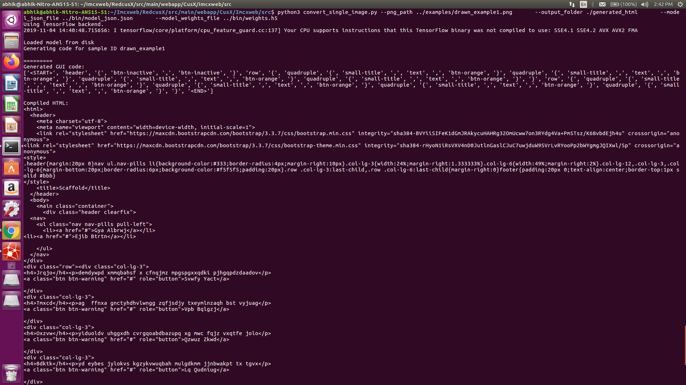
Innox
03
Regarded as one of our best services, it is the real time website builder from sketch or images. It is a fuse project and uses tensorflow js for object classification.
Demo video is present at innox
A sample of the generated output.
[A working prototype]

Slide 9
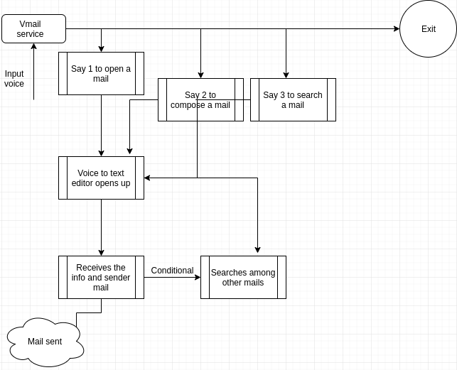
Vmail
04
Another useful tool is vmail which converts voice to text and then composes mail based upon the mail address spoken.
Demo video is present at vmail
Workflow
[A working prototype]

Slide 10
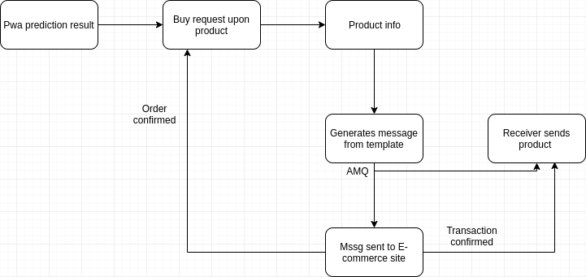
Sox
05
A progressive web app using real time product classification even when offline!!
E-commerce sites can implement this to allow it’s customers shop even when offline and carry out secured transaction through AMQ messaging.[Sends information about the transaction]
Workflow

Slide 11
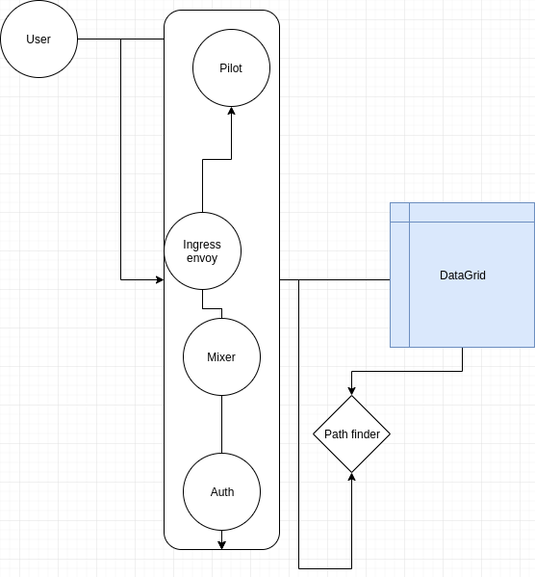
Trafene
06
Our final and personally my favourite project-
A traffic management ,routing and tracing solution provider.
It uses:- RedHat DataGrid, Graphene, Kafka- Kubernetes.
Can be used to implement faster
Routing system within applications

Slide 12
Assumptions
This is just a prototype of what we actually wanted to demonstrate.
We have added workflows and demonstrations in the video of how our services work.
We have received feedback from nearly 50 users that our project is better than most other products in the market and can be useful for many startup companies. One such example of startups id OATE INFOTECH PVT LTD. which showed extra interest to get our product but we didn’t provide the source code to anyone. [Though it was available in my GitHub,I renamed the project there.]

Slide 13
Why it’s better than existing solutions
We have the power of Red Hat products which makes it :-
More scalable- Faster deployments- Better security- Cheapest cost- Ready to use solutions.
We have attached the Google analytics report which shows that our code is of much better quality than most of the standard sites giving better performance thus like Youtube,Github,etc.

Slide 14
Next Steps

Slide 15
What next?
Some of our services are raw and we need to polish them so that they can be ready to be delivered
Customer feedback statistics to be analyzed. Implement more of data security features with Red Hat DataGrid- involves offline voice based banking.
Improvise upon our pitching video because I am not a good video maker hence , please forgive us in this respect.
This presentation is an alternate of the video.

Slide 16
Timeline
1st week
2nd week
3rd week
4th week
5-6th week
7th week
Next steps
Requirements gathering
User research
Wireframes
Review
Prototype
User testing
Dev hand-off

Slide 17
Wake up everyone!!
Let us store data to analyze our mistakes and improvise upon ourselves and make this world like the heaven we think of……………
— CusX team

Slide 18
Thanks !! to all judges

